Slide 1
Feature-based Methods
Topology of Vector and Scalar Fields II
Unified Feature Extraction Architecture
Scalar Topology + Persistence = Extremal Structures II

Slide 2
Feature-based Visualization
very important
Feature Extraction
Features:
Represent interesting structures or objects in the data
Extract and visualize them
The original (large) field is not needed anymore for visualization
Extraction can (usually) be automated
Rendering is fast and (usually) interactive
Medium to high cognitive load
Typical features:
Topological features
Vortices
Shock waves
Extremal structures
over time

Slide 3
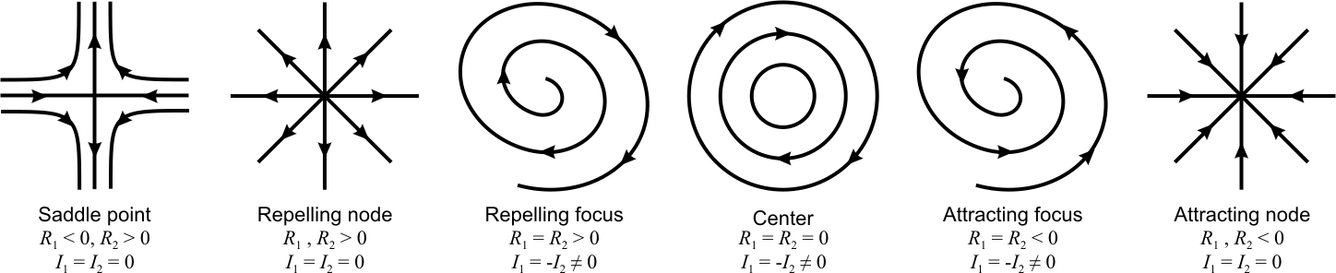
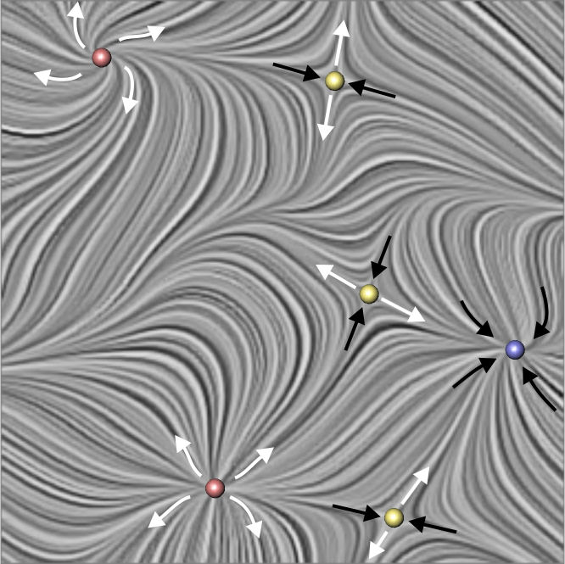
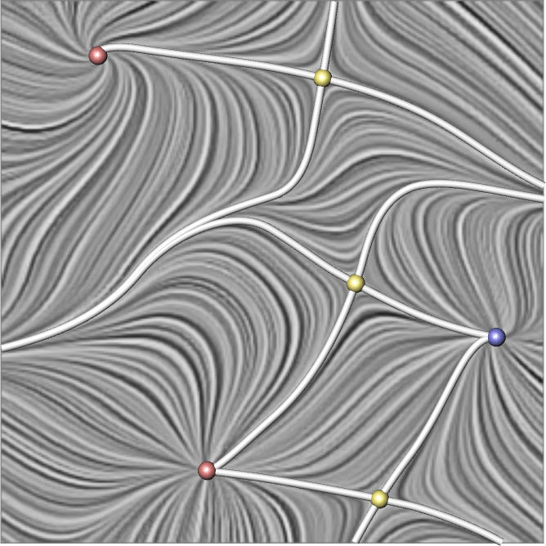
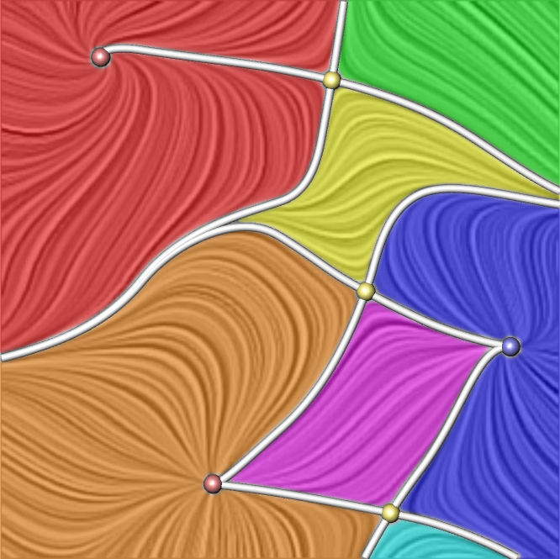
Last Lecture
critical points
separation lines
sectors of different
flow behavior

Slide 4
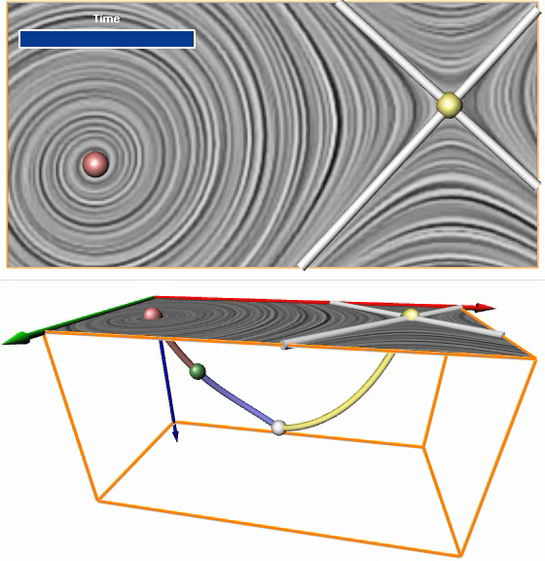
Topological Structures
unsteady vector field

Slide 5
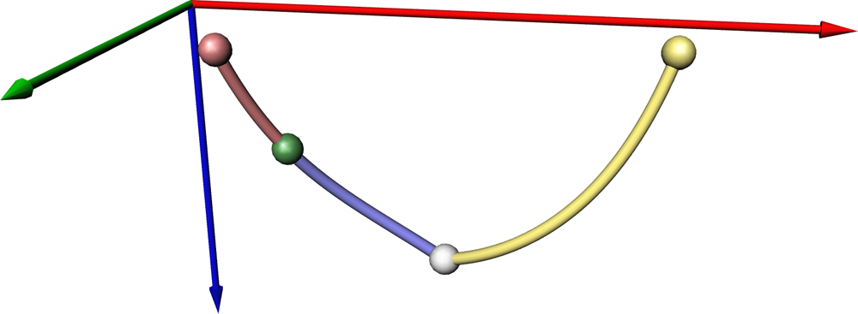
Topological Structures
unsteady vector field
Hopf bifurcation
fold bifurcation
source
sink
saddle

Slide 6
Feature-based Visualization
very important
Feature Extraction
Features:
Represent interesting structures or objects in the data
Extract and visualize them
The original (large) field is not needed anymore for visualization
Extraction can (usually) be automated
Rendering is fast and (usually) interactive
Medium to high cognitive load
Typical features:
Topological features
Vortices
Shock waves
Extremal structures

Slide 7
Flow Visualization: Problems and Concepts
Bifurcations:
sudden changes of the flow structure at a certain time

Slide 8
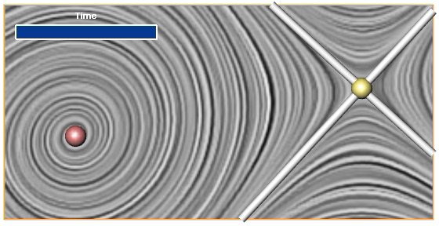
Flow Visualization: Problems and Concepts
Bifurcations:
fold bifurcations:
collapsing of a saddle with a source/sink/center and disappearance of both
reverse process

Slide 9
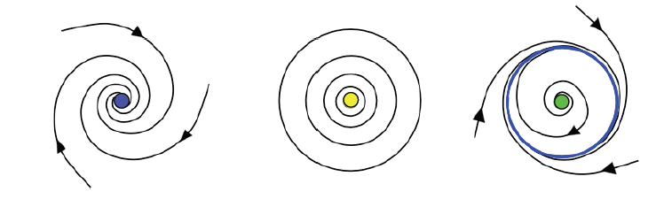
Flow Visualization: Problems and Concepts
Bifurcations:
Hopf bifurcation:
repelling focus ➔ attracting focus via center
attracting focus ➔ repelling focus via center

Slide 10
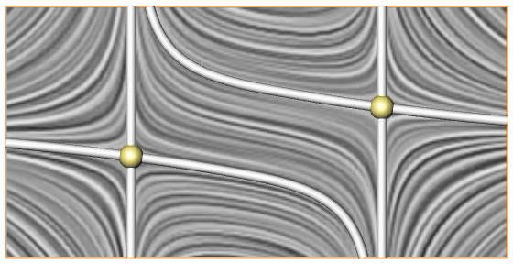
Flow Visualization: Problems and Concepts
Bifurcations:
Saddle connection:
separatrix from one saddle ends in another saddle

Slide 11
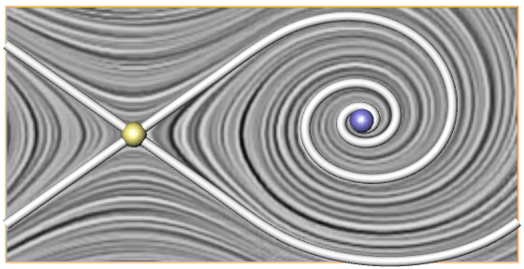
Flow Visualization: Problems and Concepts
Bifurcations:
Saddle connection:
separatrix from one saddle ends in another saddle
Special case Periodic blue sky bifurcation: separatrix of one saddle ends in the same saddle

Slide 12
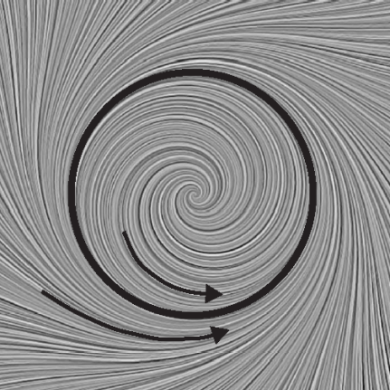
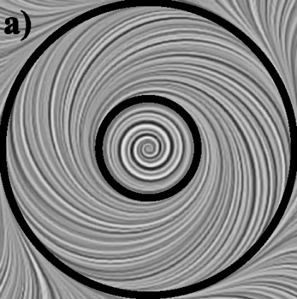
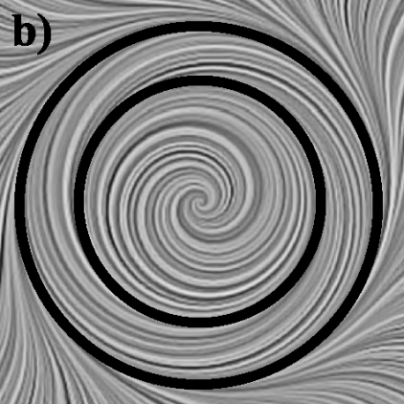
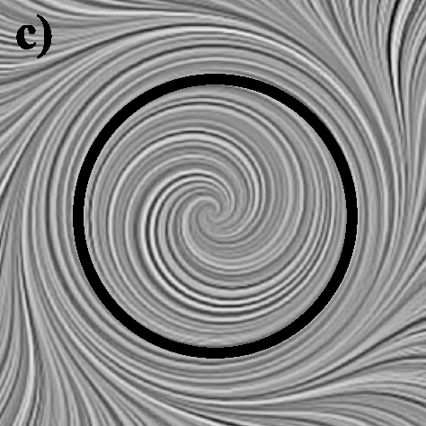
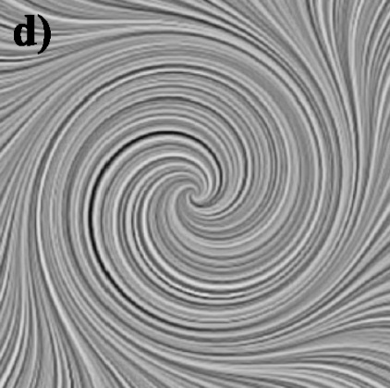
Flow Visualization: Problems and Concepts
Bifurcations:
cyclic fold bifurcation:
two isolated closed stream lines collapse and disappear
reverse

Slide 13
Approach to feature extraction follows these principles
generic concepts
reusability of algorithms
chaining of algorithms
grid independence

Slide 14
Feature | Steady | Unsteady
Critical Points | ☑ | ☑
Separatrices | ☑ | ?
Closed Stream Lines | ☑ | ☑
Saddle Connectors | ☑ | ?
Boundary Switch Points/Curves | ☑ | ☑
Boundary Switch Connectors | ☑ | ?
Vortex Core Lines | ☑ | ☑
Scalar: Minima/Maxima | ☑ | ☑
Scalar: Ridge/Valley Lines | ☑ | ☑

Slide 15

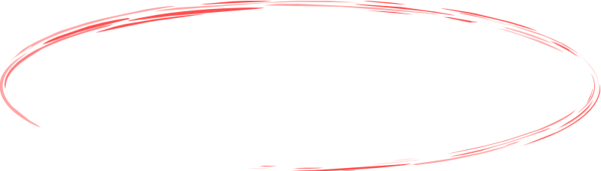
Unified Feature Extraction Architecture
A number of features can be extracted and tracked using a combination of the following core algorithms:
Finding zeros
Integrating stream objects (lines, surfaces, ...)
Intersecting stream objects
Feature Flow Fields
Connectors Approach
+ data handling, interpolation, derivation

Slide 16
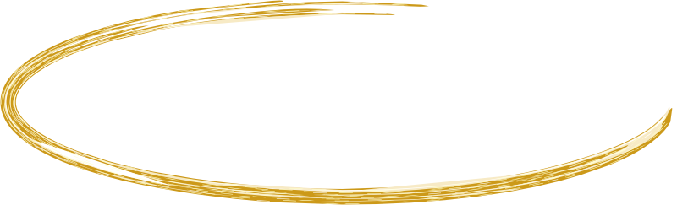
Unified Feature Extraction Architecture
Feature Flow Fields
Finding Zeros
Integrating Stream Objects
Connectors Approach
Intersecting Stream Objects

Slide 17
Unified Feature Extraction Architecture
Feature Flow Fields
Finding Zeros
Integrating Stream Objects
Connectors Approach
Intersecting Stream Objects

Slide 18
Finding Zeros
Isolated zeros
Direct solution of linear equations
Newton, ...
Hodge decomposition
Domain decomposition & change-of-sign test

Slide 19
Finding Zeros
Isolated zeros
Direct solution of linear equations
Newton, ...
Hodge decomposition
Domain decomposition & change-of-sign test
0
0
-
+
+

Slide 20
Change-of-Sign Test
Main idea based on (continued) linear interpolation
0
-
+
check for possible zero
0
-
+
+
check for possible zero
no zero possible
continue until distance between points
is below a threshold

Slide 21
Change-of-Sign Test
(+, -)
(+, -)
Criteria itself is necessary, but not sufficient
Very fast
Easy to implement (C++ Template)
n dimensions, m-dimensional values
no zero possible
(+, +)
(+, +)
(+, -)
(-, -)
zero possible
(+, +)
(+, +)
Newton, ...

Slide 22
Unified Feature Extraction Architecture
Feature Flow Fields
Finding Zeros
Integrating Stream Objects
Connectors Approach
Intersecting Stream Objects

Slide 23
Integrating Stream Objects
n-dimensional stream object obtained by starting an integration at a (n-1)-dimensional structure
Point → stream line
Curve → stream surface
Runge-Kutta
Hultquist, Stream Surfaces, IEEE Vis 1992

Slide 24
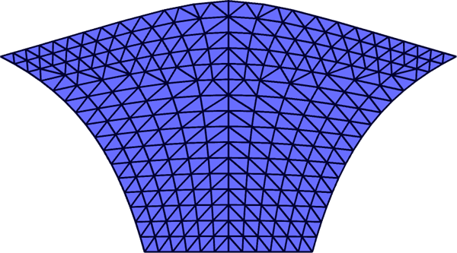
Stream Objects: Convergence / Divergence
Euclidean distance
Angle
...
see last lecture

Slide 25
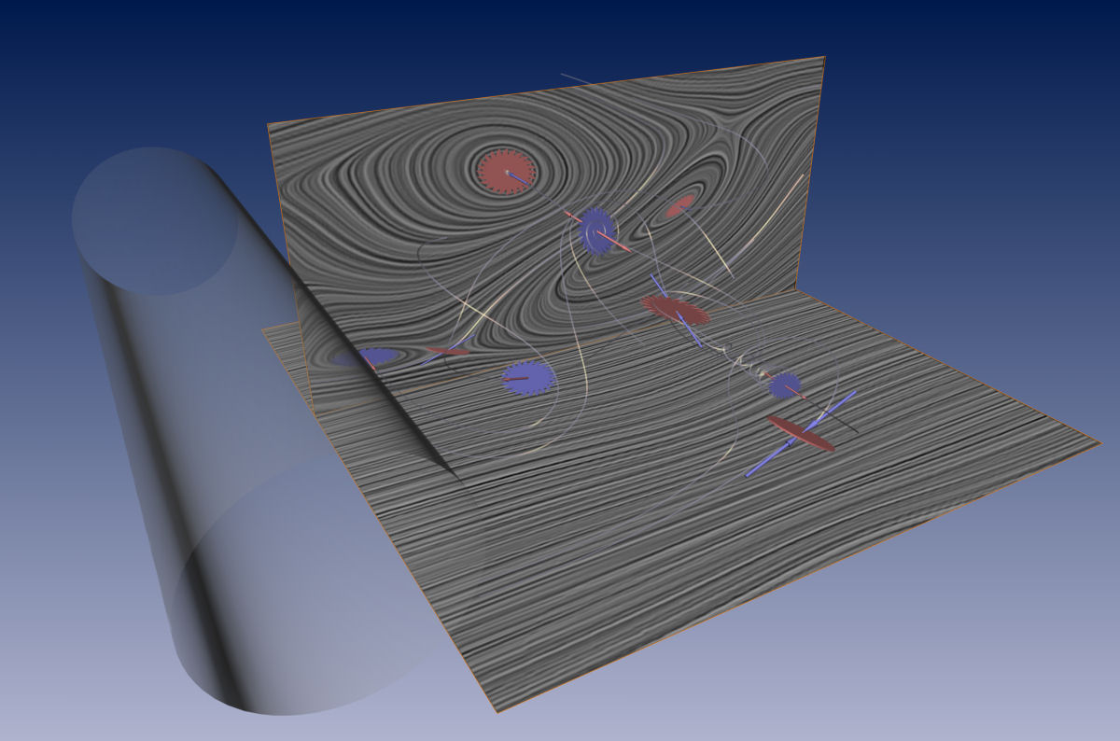
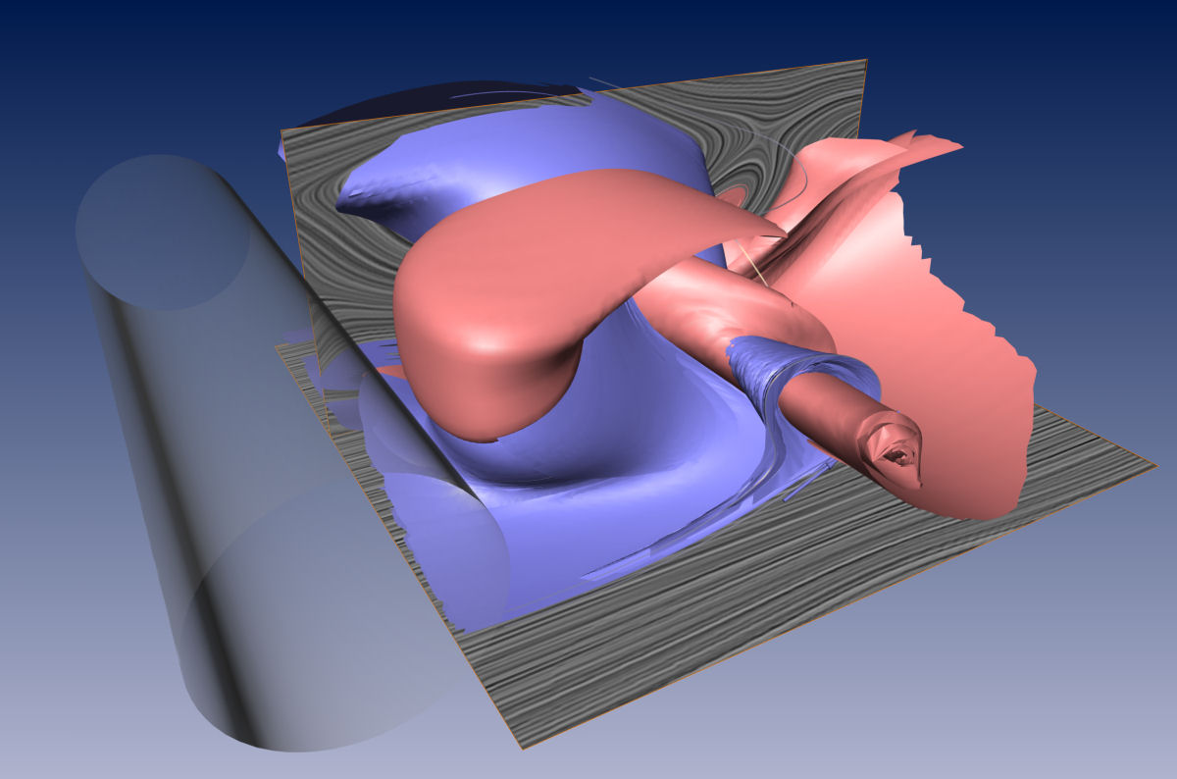
Finding Zeros
Integrating Stream Objects
Application to extracting critical points and separatrices
Flow behind a cylinder. Data courtesy of Gerd Mutschke (FZ Rossendorf) and Bernd R. Noack (TU Berlin).

Slide 26
Unified Feature Extraction Architecture
Feature Flow Fields
Finding Zeros
Integrating Stream Objects
Connectors Approach
Intersecting Stream Objects

Slide 27
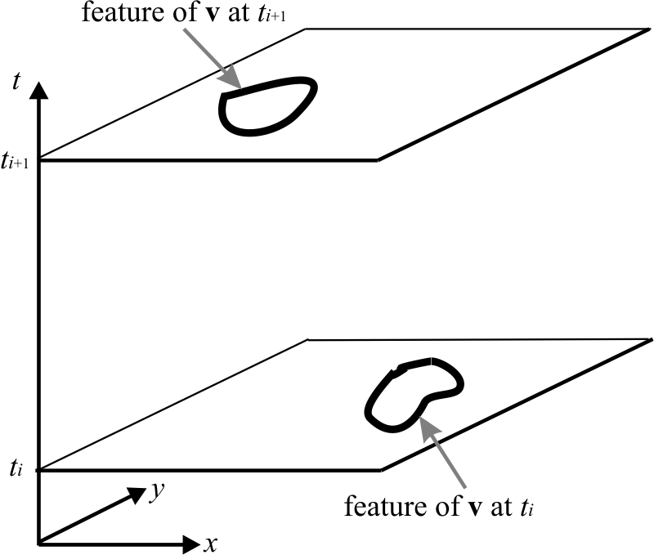
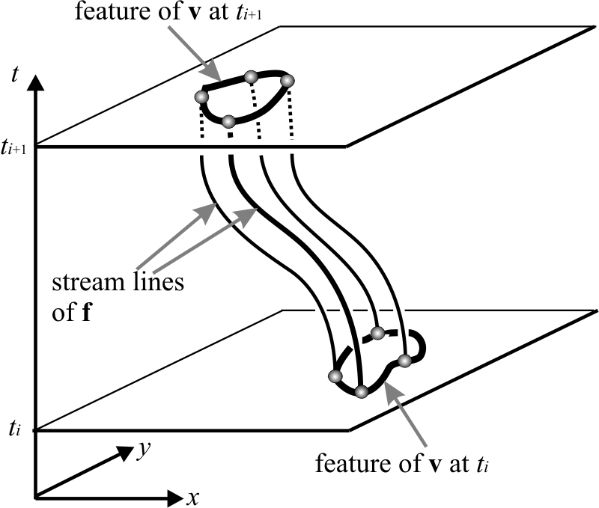
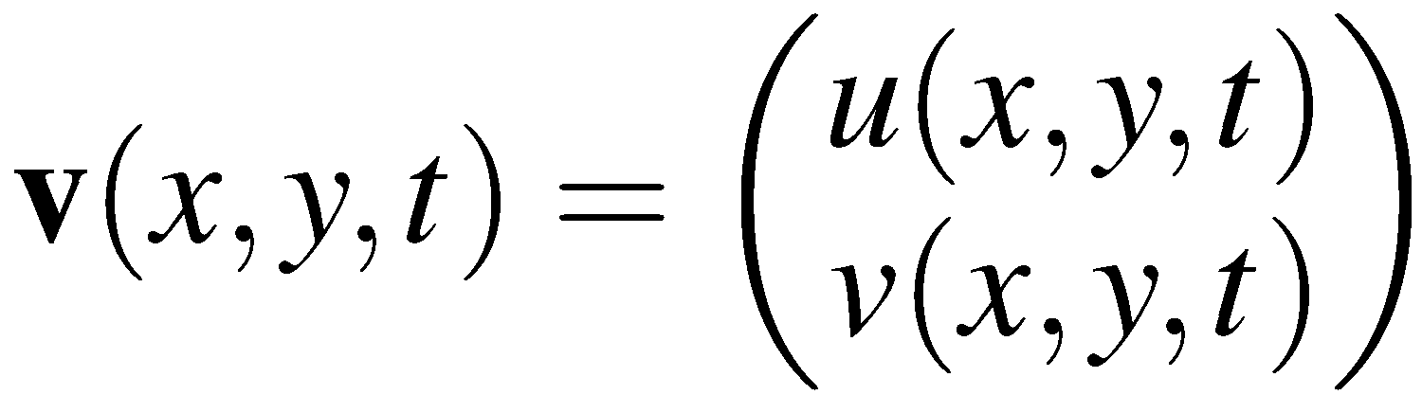
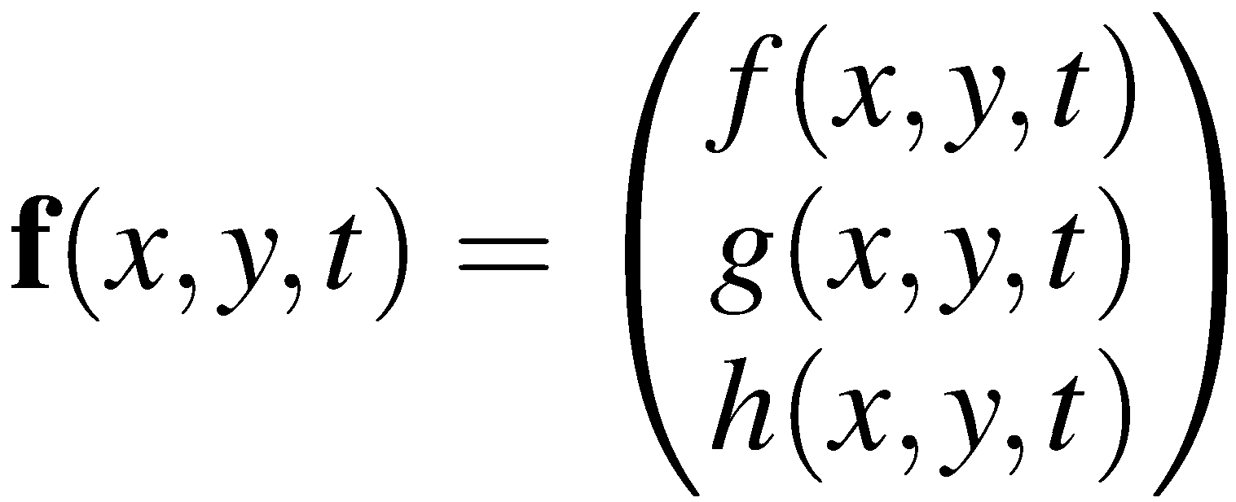
Feature Flow Fields (FFF)
Feature Flow Field (FFF)
H. Theisel and H.-P. Seidel Feature Flow Fields, VisSym 2003
Notes:
…example. Here, we have a 2D time-dependent vector field. The spatial domain is denoted by the x- and y-axis; the t-axis gives the time dimension. As we can see, the time-dependent vector field exhibits certain features at certain time steps. Now we would like to derive a…
…new vector field from it – with the property…
…that its stream lines give us the evolution of the features through space-time. We call such a derived vector field a “Feature Flow Field”.

Slide 28
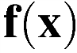
Concept of Feature Flow Fields
Feature Flow Field: vector field f at x pointing into direction where the feature continues
Numerical stream line/surface integration is well-understood
Stream object integration independent of underlying grid
FFF gives theoretical tool for classifying local bifurcations
Feature
Notes:
In other words, a FFF is a vector field that points into the direction where the feature continues. Using FFF for feature analysis has several advantages. In particular, numerical integration is well-understood – there are nice tools for this – and it is independent of the underlying grid. Furthermore, FFF gives a nice theoretical tool for classifying local bifurcations such as fold bifurcations.
However, FFF are only a generic concept. For a specific application – such as tracking critical points or extracting vortex core lines – we need a specific FFF formulation.

Slide 29
Selected Work on Feature Flow Fields
H. Theisel and H.-P. Seidel Feature Flow Fields, VisSym 2003
H. Theisel, T. Weinkauf, H.-C. Hege, and H.-P. Seidel Stream Line and Path Line Oriented Topology for 2D Time-Dependent Vector Fields, IEEE Vis 2004
T. Weinkauf, H. Theisel, H.-C. Hege, and H.-P. Seidel Feature Flow Fields in Out-Of-Core Settings, TopoInVis 2005
X. Zheng and A. Pang Topological Lines in 3D Tensor Fields and Discriminant Hessian Factorization, TVCG 2005
H. Theisel, J. Sahner, T. Weinkauf, H.-C. Hege, and H.-P. Seidel Extraction of Parallel Vector Surfaces in 3D Time-Dependent Fields and Application to Vortex Core Line Tracking, IEEE Vis 2005
S. Depardon, J. J. Lasserre, L. E. Brizzi, and J. Borée Automated topology classification method for instantaneous velocity fields, Experiments in Fluids 2007
J. Reininghaus, J. Kasten, T. Weinkauf, I. Hotz Efficient Computation of Combinatorial Feature Flow Fields, TVCG 2011
T. Weinkauf, H. Theisel, A. Van Gelder, A. Pang Stable Feature Flow Fields, TVCG 2011
C. Pagot, D. Osmari, F. Sadlo, D. Weiskopf, T. Ertl, J. Comba Efficient Parallel Vectors Feature Extraction from Higher-Order Data, EuroVis 2011
Notes:
There has been quite some work on providing such specific formulations. The first three basically deal with tracking CP, but FFF can also be used to extract topological lines in tensor fields or extract and track lines defined by the Parallel Vectors operator.
The group around Jaques Boree used FFF in a completely different way. They measured real-world flows with an optical measurement method called Particle Image Velocimetry. Unfortunately, their equipment was not fast enough to obtain a sufficient time resolution. They used FFF to define a feature-based metric between different snapshots. Based on this metric, they were able to sort these snapshots of a time-periodic flow into a single periode – thereby effectively increasing the time resolution.
And finally, FFF made it recently into the domain of combinatorial topology.
However, in this paper we are concerned with two applications: Tracking CP, and extracting lines defined by the PV operator.

Slide 30
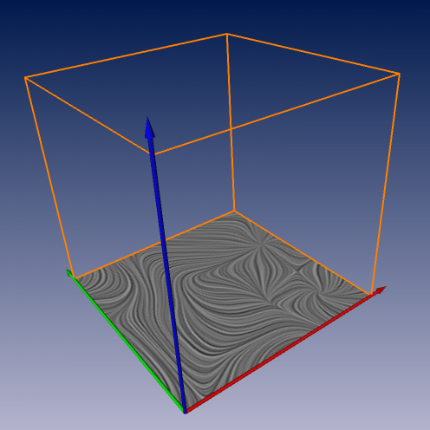
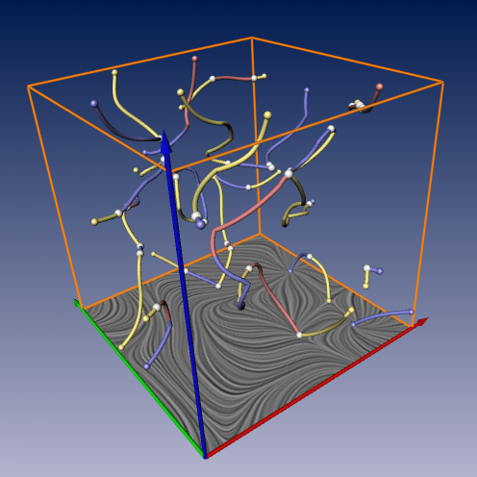
Tracking Critical Points in 2D
1. Find all seeds
2. Integrate
unsteady vector field
tracked critical points
FFF-based Tracking
Notes:
Let’s have a look at the first application: We have a 2D time-dependent vf
and want to find all occurrences of all critical points throughout space and time. Using FFF,
this is a two-step process. First, we need the find all seeding points that give rise to all occurrences of all critical points. Then, we need to integrate in our FFF starting from these seeds.

Slide 31

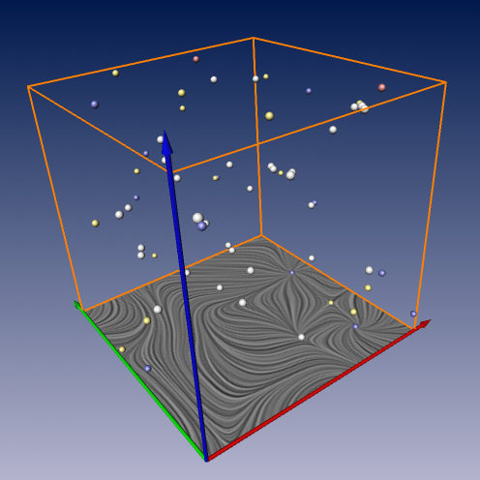
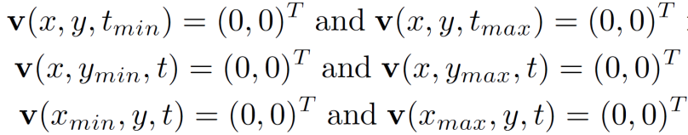
Tracking Critical Points in 2D
1. Find all seeds
2. Integrate
Finding Zeros
Domain boundaries
Fold bifurcations

Slide 32
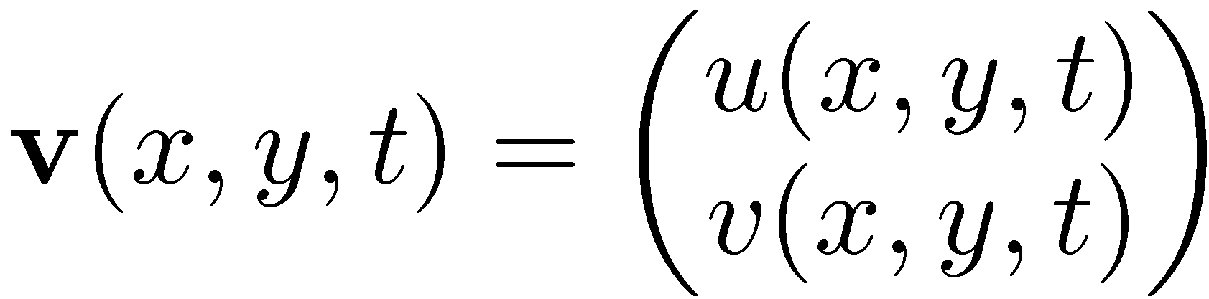

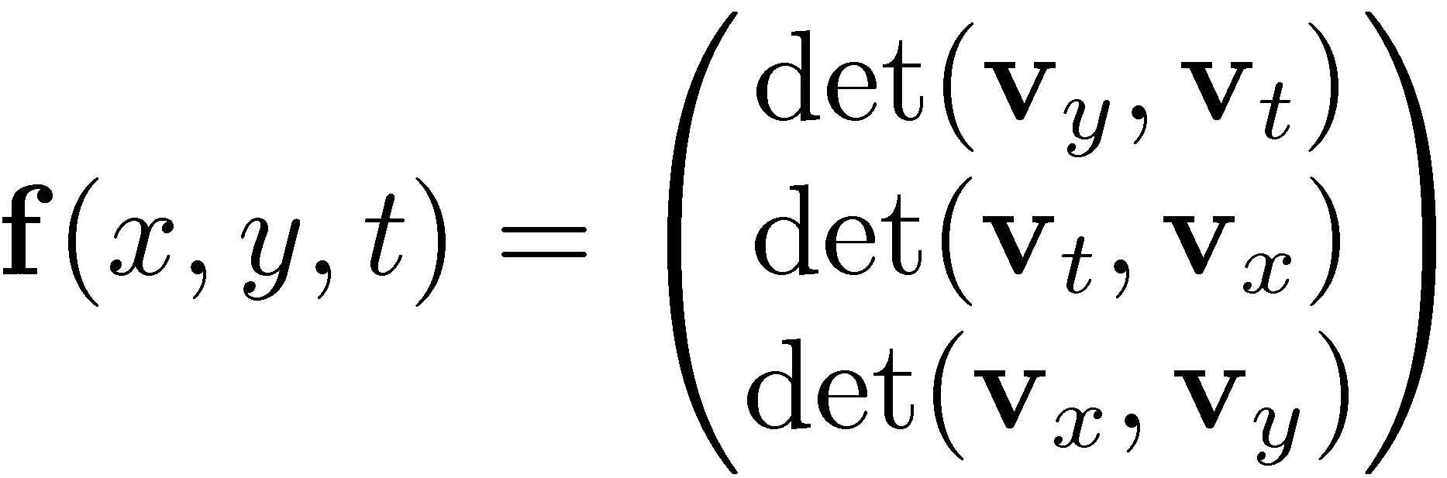
Tracking Critical Points in 2D
2. Integrate
1. Find all seeds
Integrating Stream Objects
[Theisel and Seidel; VisSym 2003]
Classic FFF definition:
Stability?
Large data (out-of-core)?

Slide 33
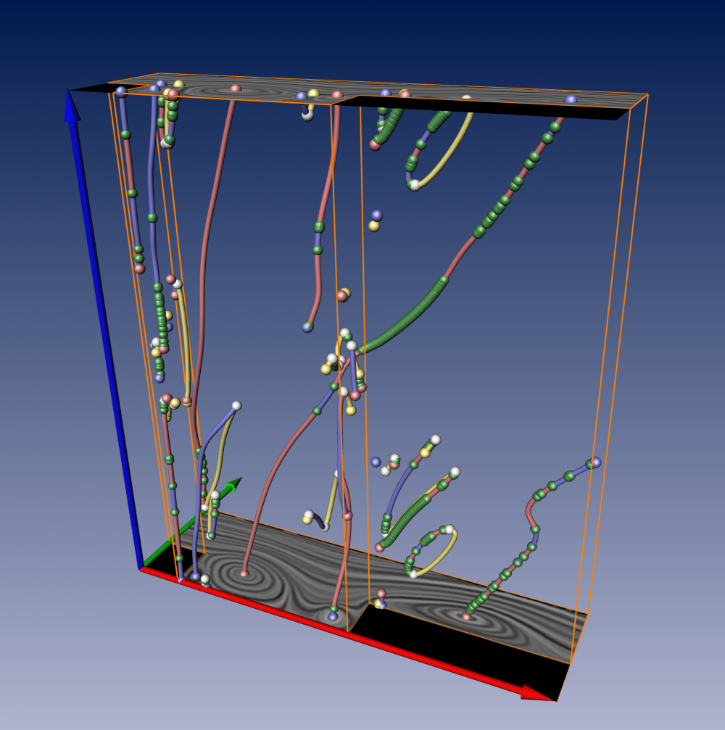
Flow around a 2D Cavity. Data courtesy of Samimy, Noack.
1000 time steps
Notes:
Here, we applied this to a flow around a 2D cavity. It consists of 1000 time steps and we tracked all the cp. As you can see, it has a quasi-periodic behavior. The image on the right shows the first periode; approx. the first 100 time steps. [let it sink in or say something]
I would like to point your attention to this closed-loop feature line over here. Let us zoom closer…

Slide 34
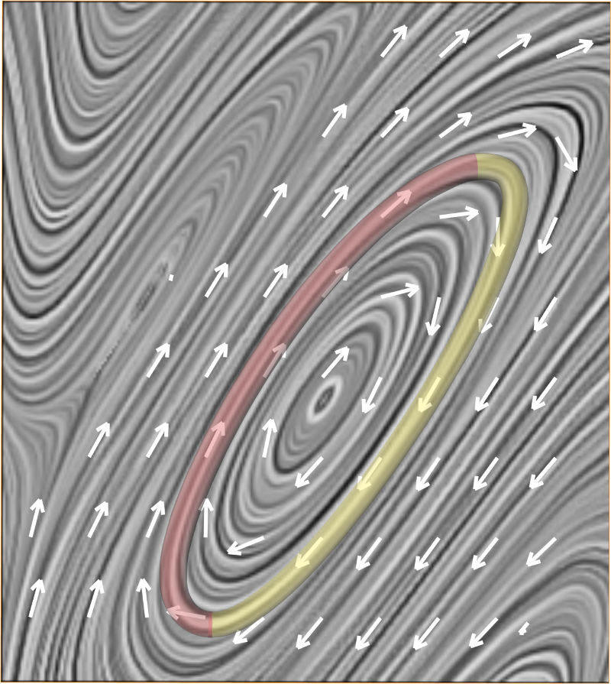
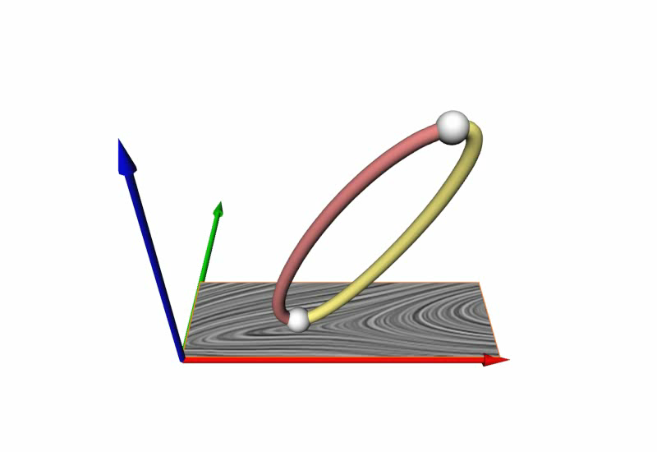
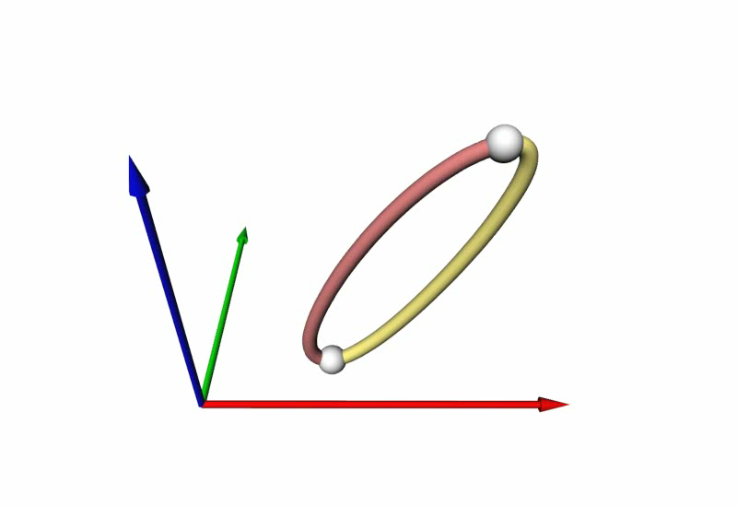
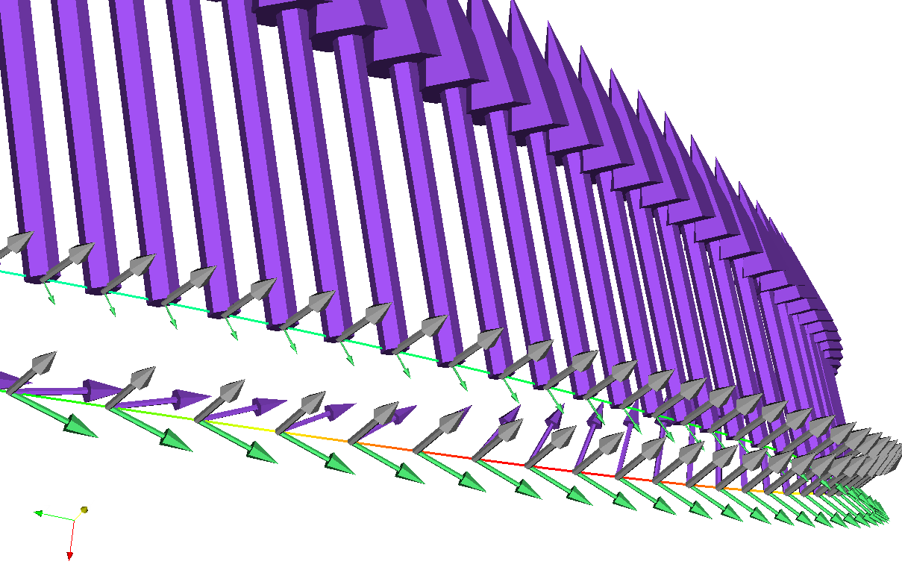
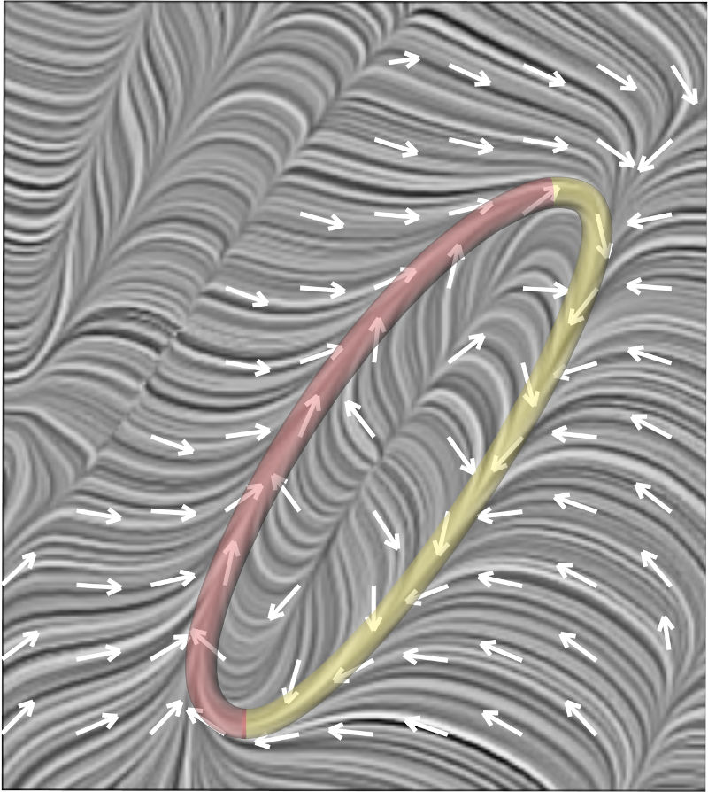
Classic FFF
A. Van Gelder, A. Pang Using PVsolve to Analyze and Locate Positions of Parallel Vectors, IEEE TVCG 15(4):682-695, 2009.
Predictor-Corrector approach
FFF integration
Root finding
Desired
Notes:
We have two fold bifurcations. The first one gives rise to a critical point, which splits up immediately into two cp of opposite Poincare index.
[play video]
In this case, a saddle and a source. They are distinct from each other for some time, until they come closer to each other, merge and disappear at the second fold bifurcation.
Now, this is a perfect setting to see what happens if we integrate for very long in our FFF. Because,
we have to stay on the closed-loop. But as it turns out, we diverge from it after a number of integration steps.
The reason for this becomes more clear, if we look at a LIC plane that we put into the plane of the feature line. As it turns out, once we make a small integration error, once we step a little bit off the feature line for whatever reason – we won’t return to it, since the stream lines in the neighborhood of our feature line move us away from it; they do not bring us back, they do not converge to the feature line.
A&A noticed this first. They proposed a PC approach. So, first some FFF integration steps, then a root finding to return to the feature line. However, this is of course more difficult to program and it is also computationally more expensive due to the root finding.
In this paper, we want to propose a different solution.
We want to change the behavior of the stream lines in the proximity of the feature line. We want to create a converging stream line behavior, such that we will always return to the feature.

Slide 35
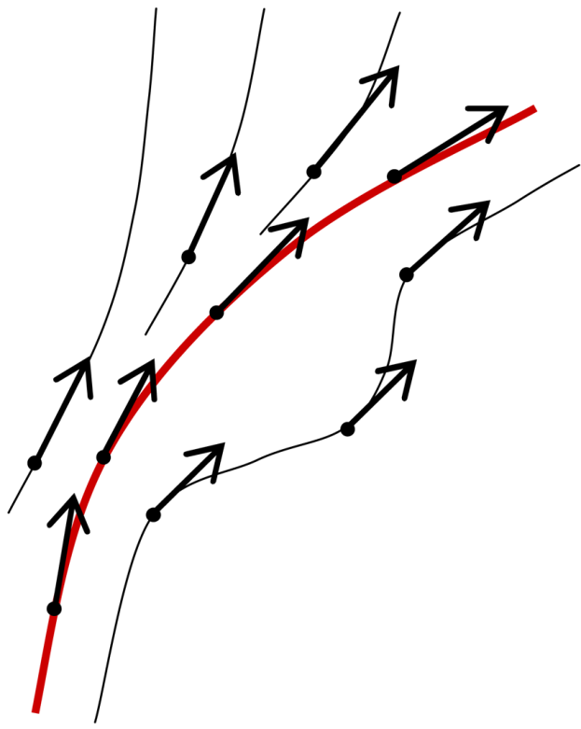
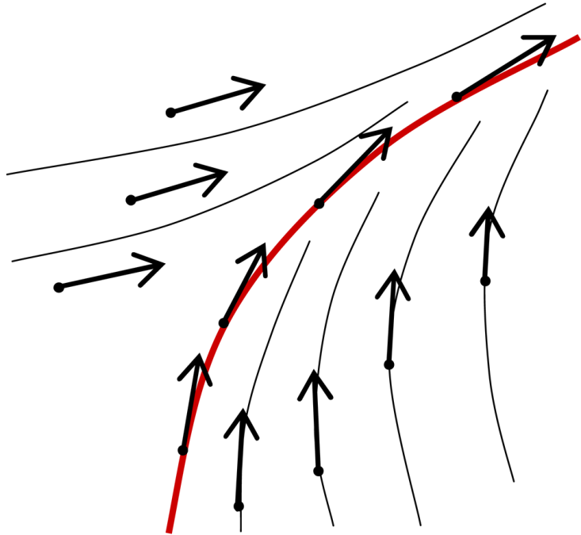
Contributions
Original FFF
Mathematically correct
Possibly numerically unstable
Numerical errors may move the integration slightly off the feature. Then it may get carried away.
Designed to preserve the data value along any stream line in the whole domain, i.e., errors are preserved.
Stable FFF
Mathematically correct
Numerically stable
Converging flow behavior in the neighborhood of the feature line.
➔ Automatic correction of small errors.
Two new stable FFF formulations
Tracking critical points
Extracting Parallel Vector lines
Notes:
We give the following contributions.
We analyze the original FFF. And find that it is mathematically correct; in the sense, that the feature line is a stream line of our FFF.
However, it might be numerically unstable for two reasons:
[reason 1]
This is true for all numerical integrations – whether you integrate in an FFF or any other field. However, the second reason is specific for FFF:
[reason 2]
We introduce Stable FFF.
They are mathematically just as correct as the original FFF; in the sense, that the feature line is a stream line of our FFF.
However, they are numerically stable, since we guarantee a converging flow behavior in the proximity of the feature line. This allows for an automatic correction of small errors.

Slide 36
Classic and Stable FFF formulation
Tracking Critical Points
Notes:
Let’s come to our first app. Tracking CP.

Slide 37
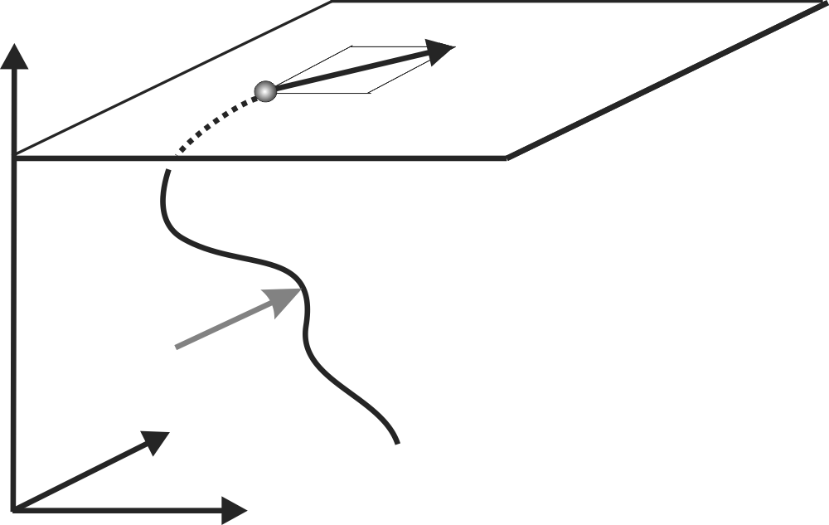
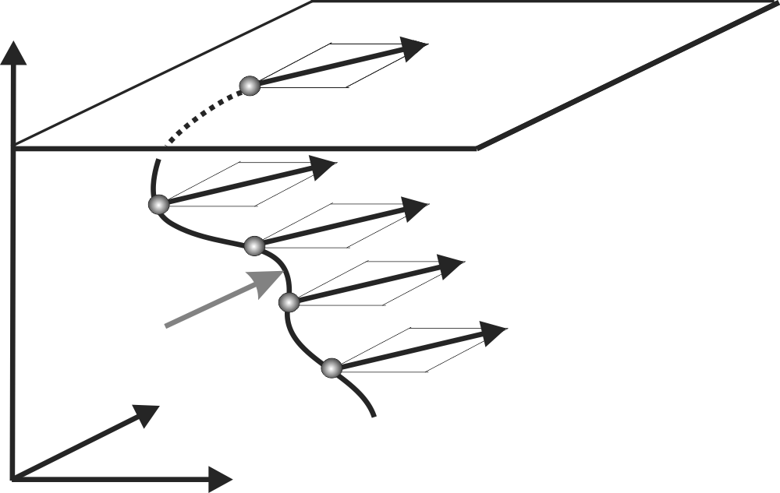
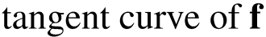
Original Definition of FFF for Tracking Critical Points
unsteady 2D vector field
feature flow field
Feature flow field f shall point into the direction
where the original vector field v is not changing
in terms of both magnitude and direction.
Notes:
The original idea for FFF for tracking CP is based on the following idea:
[read it]
So, we have a certain vector at some point in space-time in our original vf.
The FFF gives us a tangent curve through space-time
with the property that every point on this curve
has the same vector as the first one. Because the FFF preserves magnitude and direction.

Slide 38
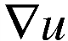
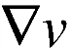
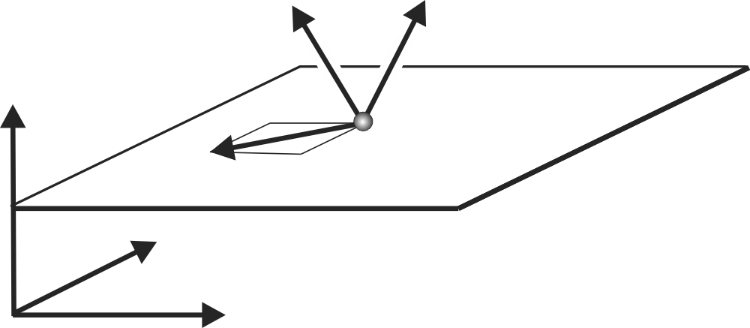
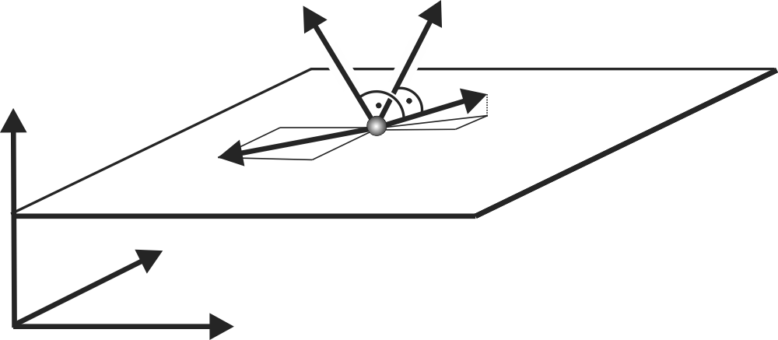
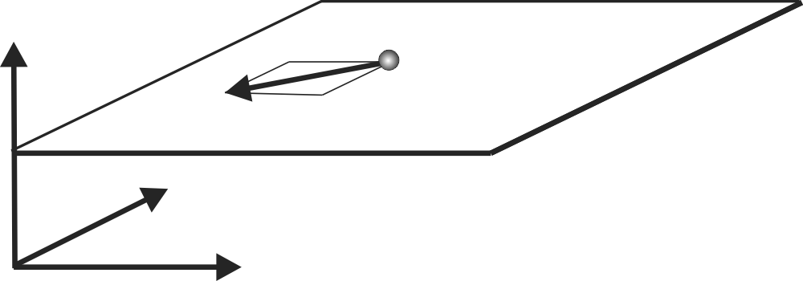
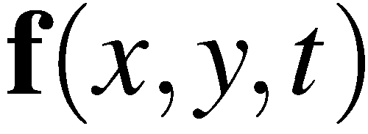
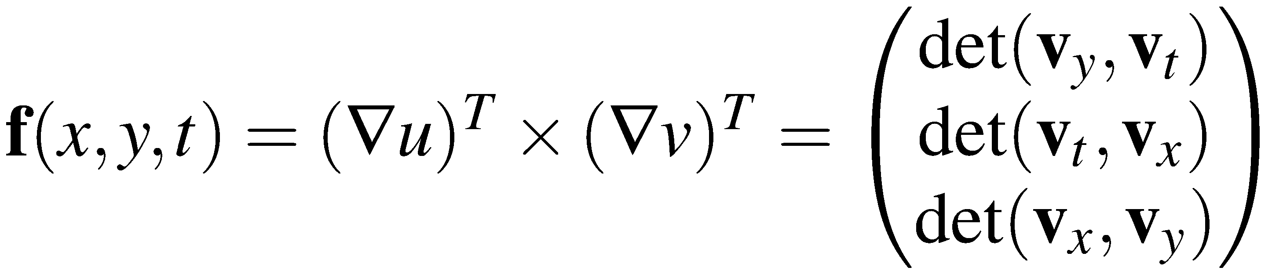
Original Definition of FFF for Tracking Critical Points
unsteady 2D vector field
feature flow field
Feature flow field f shall point into the direction
where the original vector field v is not changing
in terms of both magnitude and direction.
Original FFF definition from
[Theisel and Seidel; VisSym 2003]
Notes:
Mathematically, we can express this by looking at the first derivative of the original VF.
Namely, the gradient vectors of the components. They are perpendicular to the respective isosurface of each component.
The intersection of these isosurfaces gives us the direction into which both components do not change, or in other words, into which our vf does not change.
Hence, we find our FFF as the cross-product of these two gradient vectors.

Slide 39
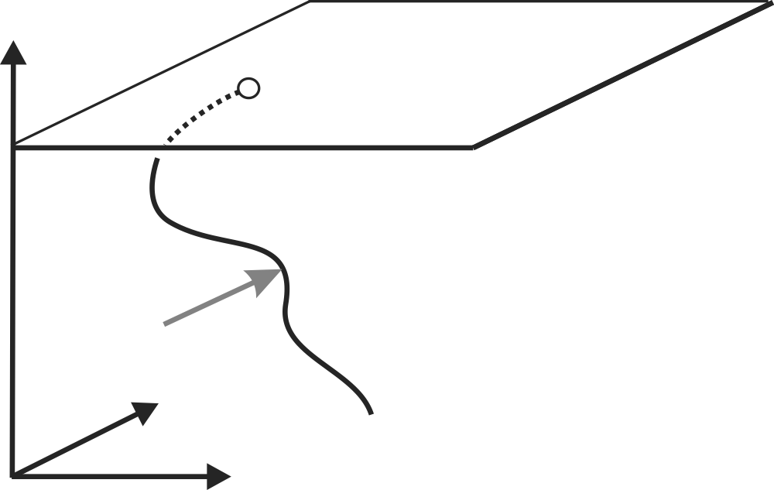




Original Definition of FFF for Tracking Critical Points
Required
Not necessary
Tracks critical points
Tracks non-critical points
Original FFF definition from
[Theisel and Seidel; VisSym 2003]
Notes:
And it makes sense. If we start an integration in this field from a critical point,
then we preserve magnitude and direction – in other words, we preserve the fact that it is a zero – and we track this critical point through space-time.
On the other hand, we also track non-critical points with this FFF.
And while the first property is required – we want to track cp after all – the second is not necessary. In fact, it will be this part of the FFF that we are going to attack, that we are going to change in order to provide a converging stream line behavior around our feature line.

Slide 40







Stable Definition of FFF for Tracking Critical Points
acts as sink around
Original FFF
Details in the paper
Stable Feature Flow Field
Notes:
To do so, we introduce an auxiliary field g, with the property that it acts as a sink around the feature line.
It has a second property. At the feature line itself, it is zero.
Now we combine this with the original FFF
[slow]
by adding both vector fields,
such that we have a converging flow behavior in the proximity of the feature curve,
and at the curve itself, we are still using the original FFF, since our auxiliary field is zero there.
In front of our auxiliary field, we have this factor alpha.
Alpha is a non-constant, smooth scalar field, that is computed from the original flow – details are in the paper.
Alpha is defined such that we have a guaranteed converging flow behavior throughout the domain.
Such that h is the Stable Feature Flow Field we were looking for.

Slide 41


Stable Definition of FFF for Tracking Critical Points
Original FFF
Stable Feature Flow Field
Notes:
Let’s put this to a test.
One the left side we have the original FFF which diverges from the closed-loop feature line after a larger number of integration steps.
The Stable FFF, on the other hand, stays on the feature line. Forever. Or until we switch off the computer.

Slide 42

Original FFF
Stable FFF
Flow around a 2D Cavity. Data courtesy of Samimy, Noack.
1000 time steps
Notes:
Here we have again the flow around the cavity, where we compare the results of both approaches.
Two regions with the largest differences are highlighted. Let’s zoom in.

Slide 43




Notes:
We have error plots here. On the x-axis, we have the integration time normalized to the interval [0,1].
On the y-axis, we have the vector field magnitude. This is our error measure, and of course we want it to be zero, since a cp has zero magnitude.
In the first plot, we see that after half of the integration time, both schemes went into a numerically difficult situation. The original fff diverged then from the CP, and then it didn’t return to it. In fact, it preserves the error and stays away from the cp for the rest of the integration.
The stable FFF, on the other hand, well, it also came into trouble, but it could make up for it, and it decreased the error during the rest of the integration.
In the second plot, we look again at our closed-loop feature line from the beginning. The original FFF accumulates error, the stable FFF stays on the line with a very low error.

Slide 44



Seed Point Perturbation
Analytic example SinusCircle: critical points on unit circle in y-t plane
Notes:
Remember, that we have to extract seeding points first, before we can start our integrations in the FFF.
And this is of course also a numerical algorithm with a certain error.
In this test, we look at the stability of the two FFF approaches with respect to a perturbation of the seeding location.
[start video]
We have an analytic test case here, where we know the ground truth.
It is basically this circle here, which is again a closed-loop feature line.
When we perturb the seeding point, the original FFF clearly diverges from the ground truth.
The stable FFF, on the other hand, makes up for the introduced error, returns to the ground truth, and gives a robust extraction result.

Slide 45
Tracking Critical Points in 2D
2. Integrate
1. Find all seeds
Integrating Stream Objects
[Theisel and Seidel; VisSym 2003]
t
x
not efficient in out-of-core context

Slide 46
Tracking Critical Points in 2D
1. Find all seeds
2. Integrate
t
t
x
x
Domain boundaries
Fold bifurcations
Occurences of feature at t_min
Birth Events
Entry Events

Slide 47

Tracking Critical Points in 2D
2. Integrate
1. Find all seeds
Slice-wise data access
Each data item is visited once
One sweep through the data
Only two time slices at once in memory

Slide 48
Flow around a 2D Cavity. Data courtesy of Samimy, Noack.
1000 time steps

Slide 49
Unified Feature Extraction Architecture
Feature Flow Fields
Finding Zeros
Integrating Stream Objects
Connectors Approach
Intersecting Stream Objects

Slide 50



Connector
Stream object which passes through both A and R
unstable
Stable features are desired
stable

Slide 51

Connectors as intersection of stream objects

Slide 52
Unified Feature Extraction Architecture
Feature Flow Fields
Finding Zeros
Integrating Stream Objects
Connectors Approach
Intersecting Stream Objects

Slide 53


Intersecting Stream Objects

Slide 54
Intersecting Stream Objects
Finding a connector that represents the intersection of two stream surfaces:
Integrate forward/backward surface step-wise.
Find the first intersection point between them
One intersection point suffices to extract the whole connector, since the connector is a stream line

Slide 55

Finding Zeros
Integrating Stream Objects
Intersecting Stream Objects
Application to extracting saddle connectors
Flow behind a cylinder. Data courtesy of Gerd Mutschke (FZ Rossendorf) and Bernd R. Noack (TU Berlin).

Slide 56

Extraction of Closed Stream Lines
Finding Zeros
Intersecting Stream Objects
Application to extracting closed stream lines in planar flows

Slide 57






Slide 58


Extraction of Closed Stream Lines

Slide 59

Extraction of Closed Stream Lines

Slide 60

Extraction of Closed Stream Lines

Slide 61

Extraction of Closed Stream Lines
Finding Zeros
Intersecting Stream Objects

Slide 62






Tracking of Closed Stream Lines
Tracking closed stream lines
Repeated application of “Intersecting Stream Objects”
Starting from:
Hopf bifurcations
Periodic blue sky bifurcations
Closed stream lines at the first or last time step
Closed stream lines touching the boundary of the domain
Cyclic fold bifurcations

Slide 63

Tracking of Closed Stream Lines
Close-up of a tracked closed stream line.
The searching arcs and the resulting seeding line are shown as gray lines.

Slide 64





Cyclic fold bifurcation
Tracking closed stream lines
Saddle connection
Periodic blue sky bifurcation

Slide 65



Cavity
tracked closed stream line
Flow around a 2D Cavity. Data courtesy of Samimy, Noack.
saddle connection
1000 time steps

Slide 66



UFEA: Other features
Cores of swirling motion
Based on stream lines (Sujudi and Haimes, AIAA 95)
Based on path lines
Vortex cores as extremal lines
Height ridges/valleys
Separatrices of the topological skeleton

Slide 67
Feature Flow Fields
Finding Zeros
Integrating Stream Objects
Connectors Approach
Intersecting Stream Objects
Feature | Steady | Unsteady
Critical Points | ☑ | ☑
Separatrices | ☑ | ?
Closed Stream Lines | ☑ | ☑
Saddle Connectors | ☑ | ?
Boundary Switch Points/Curves | ☑ | ☑
Boundary Switch Connectors | ☑ | ?
Vortex Core Lines | ☑ | ☑
Scalar: Minima/Maxima | ☑ | ☑
Scalar: Ridge/Valley Lines | ☑ | ☑
very important

Slide 68
Feature Flow Fields
Finding Zeros
Integrating Stream Objects
Connectors Approach
Intersecting Stream Objects
Parallel Vectors (PV) operator
Peikert and Roth, IEEE Vis 1999
The only other generic approach to feature extraction
Swirling motion cores, ridges, …
b
b
b
b
a
a
a
a
PV line
Treats local features only
Proven that every PV problem can be reformulated using FFF
UFEA is the first generic approach to feature extraction treating local and global features
very important

Slide 69
Discussion Topology
(mainly restricted to continuous vector field topology)

Slide 70


Discussion: Complexity
(Almost) no features
Topological methods fail
Galilean (in)variance
Too many features
Visual clutter
Saddle Connectors, Boundary Switch Connectors
Mixing layer. Data courtesy of Pierre Comte (U Strasbourg).
Restrictions for 3D topology
Technical: involved computation
Perceptional: 3D sectors
Original frame of reference: no critical points
Theoretical: The number of sectors of different flow behavior grows in the worst case quadratically with the number of saddle points in a 3D vector field.
After removing ambient part: 348 critical points

Slide 71



Flow around a backward-facing step. Data courtesy of Kaltenbach and Janke (TU Berlin).

Slide 72
Discussion: Path lines and Galilean Invariance
Topology of path lines
classic approaches fail (infinite integration not possible)
finite time behavior of path lines (FTLE)
time-periodic flows (Shi et al.)
Galilean Invariance
topology of velocity field: not invariant
topology of Galilean invariant measure: invariant as well

Slide 73
Feature-based Methods
Scalar Topology + Persistence = Extremal Structures II

Slide 74
Extremal structures of a 1D function
y=f(x)
x
maximum
minimum
The extremal structures of a 1D function are:
minima and maxima
(often also called extrema)

Slide 75


Slide 76


Slide 77




maximum
minimum
saddle

Slide 78





critical points as defined by the gradient
general vector fields

Slide 79


Separatrices
integral lines of the gradient
➔ follow the steepest ascend
➔ perpendicular to isocontours

Slide 80
Separatrices
integral lines of the gradient
➔ follow the steepest ascend
➔ perpendicular to isocontours
started at saddle points
extremal structures

Slide 81

Separatrices
integral lines of the gradient
➔ follow the steepest ascend
➔ perpendicular to isocontours
started at saddle points
extremal structures

Slide 82

Separatrices
integral lines of the gradient
➔ follow the steepest ascend
➔ perpendicular to isocontours
started at saddle points
extremal structures

Slide 83
Separatrices
integral lines of the gradient
started at saddle points
extremal structures
global structures we cannot decide locally, whether a point is on a separatrix or not.
parallel computation limited

Slide 84


Continuous view
Discrete view

Slide 85
Discrete Morse Theory
Using discrete Morse theory (R. Forman)
completely combinatorial
no numerics
no derivatives
no interpolation
no integration of separatrices
no parameters
Discrete view

Slide 86

Discrete Morse Theory
Representation:
Minima Vertices
Saddles Edges
Maxima Triangles
Maximal line:
sequence edge – triangle links
Minimal line:
sequence edge – vertex links
Combinatorial representation
of critical points and separatrices

Slide 87






Oversegmentation & Topological Simplification
Persistence
significance of critical points
H. Edelsbrunner et al.
Hierarchical Morse-Smale Complexes for Piecewise Linear 2-Manifolds, 2003

Slide 88

Persistence of a 1D function

Slide 89


Summary Discrete Scalar Topology
Morse-Smale Complex
Minima, Maxima, Saddles
Separation Lines ➔ minimal/maximal lines
Discrete computation
Topological simplification using persistence

